Slide 1
How to write a research paper
Inspired from Simon-Peyton Jones's presentation

Slide 2
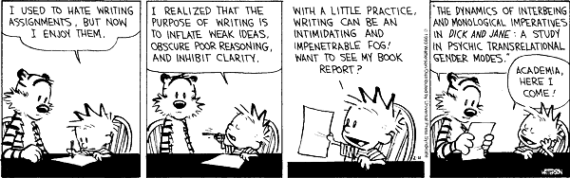
Fallacy
Impress others is the goal? Nope!

Slide 3
Papers communicate ideas
Your goal is to infect the reader's mind
Papers are durable
More than implementations
More than personal knowledge

Slide 4
Writing model I
Idea
Do research
Write

Slide 5
Writing model II (even better)
Idea
Write
Do research
Write

Slide 6
Writing complements work
Force to be clear and focused
Crystallizes what is not understood
Opens the way to dialogue and sharing
Reality checks
Critique
Collaboration

Slide 7
Describe ideas, not systems
Readers care about re-usable brain-stuff
Not executable artifacts

Slide 8
Writing and ideas
Here is a problem
It's an interesting problem
Here is my idea
My idea works (details, data)
Here's how my idea compares to other people's approaches

Slide 9
Structure (YMMV, 110%)
Abstract (4 sentences)
Introduction (10%)
The problem (10%)
My idea (20%)
The details (50%)
Related work (15%)
Conclusions and future work (5%)

Slide 10
Abstract
Four sentences
The problem
Why it's interesting
What your solution achieves
What follows from your solution
Advice: write it last

Slide 11
Example abstract
Many papers are badly written and hard to understand
This is a pity, because their good ideas may go unappreciated
Following simple guidelines can dramatically improve the quality of your papers
Your work will be used more, and the feedback you get from others will in turn improve your research

Slide 12
The introduction
Describe the problem
State your contributions

Slide 13
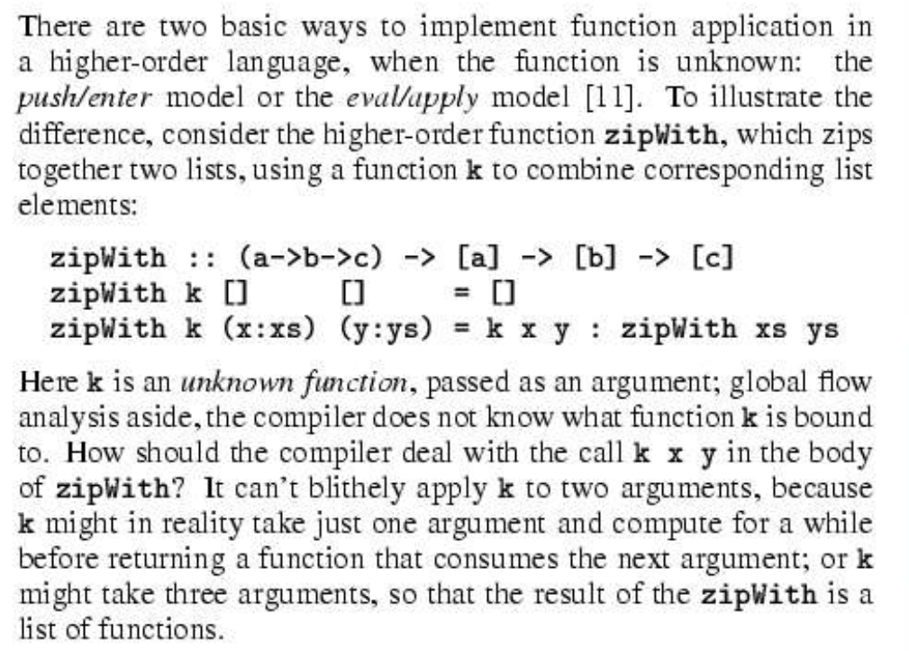
Describe the problem
Use an example to introduce the problem
Or at least stay clear and applied

Slide 14
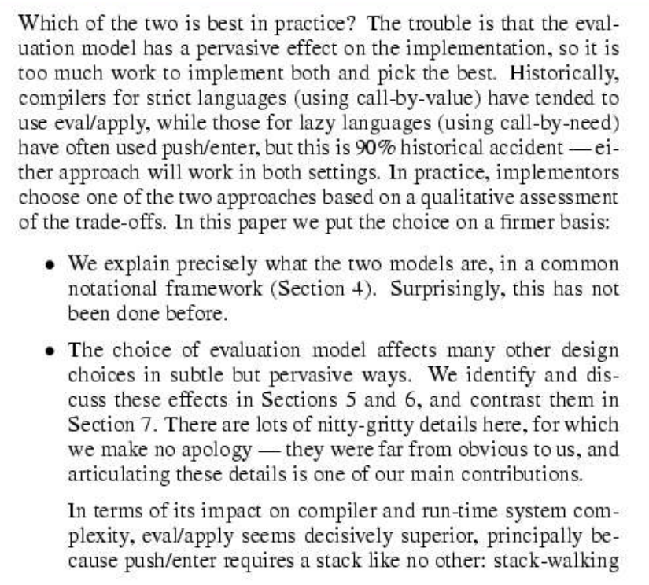
Your contributions
Be very precise
Do not leave the reader to guess
Use bullets

Slide 15
Your contributions
We describe the WizWoz system. It is really cool. | We give the syntax and semantics of a language that supports concurrent processes (Section 3). Its innovative features are...
We study its properties. | We prove that the type system is sound, and that type checking is decidable (Section 4).
We have used WizWoz in practice. | We have built a GUI toolkit in WizWoz, and used it to implement a text editor (Section 5). The result is half the length of the Java version.
Contributions should be
Specific
Provable (or refutable)

Slide 16
Forward references
Use forward references from the narrative in the introduction
The introduction should survey the whole paper
Forward reference every important part

Slide 17
No references and related work yet
Do not get between the reader and the idea
The reader does not know the problem yet, so other people's work is absolutely incomprehensible
We adopt the notion of transaction from Brown [1], as modified for distributed systems by White [2], using the four-phase interpolation algorithm of Green [3]. Our work differs from White in our advanced revocation protocol, which deals with the case of priority inversion as described by Yellow [4].

Slide 18
The problem
Concentrate single-mindedly on a narrative that
Describes the problem, and why it is interesting
Describes your idea or solution
Defends your idea, showing how it solves the problem and filling out the details
Cite relevant work in passing
Defer discussion to the end

Slide 19
The payload of your paper
Use examples to introduce the problem and your idea
Only after you may present the general case

Slide 20
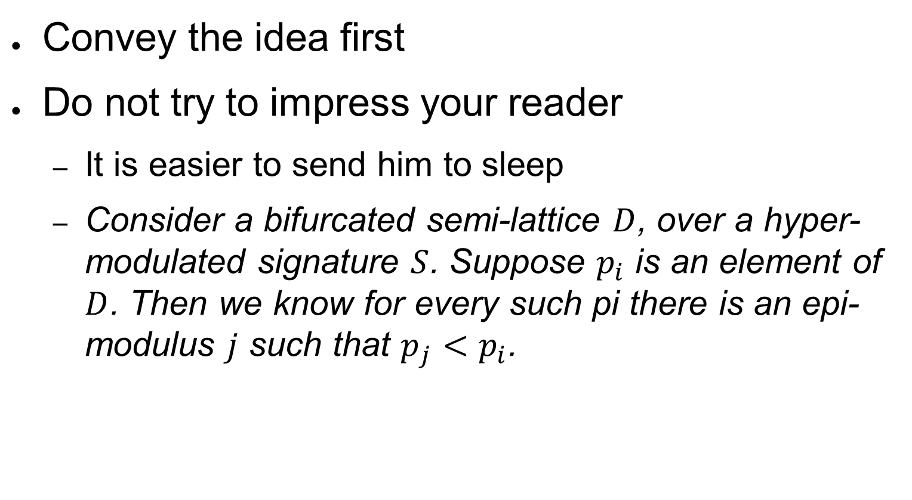
The payload of your paper
Convey the idea first
Do not try to impress your reader
It is easier to send him to sleep
Consider a bifurcated semi-lattice $D$, over a hyper-modulated signature $S$. Suppose $p_{i}$ is an element of $D$. Then we know for every such pi there is an epi-modulus $j$ such that $p_{j}<p_{i}$.

Slide 21
Conveying the idea
Explain as if on a whiteboard
The intuition is at the core
Once your reader has the intuition, she can follow the details
Not the other way around
Even with no details the reader takes away something of value
Sometimes just title, abstract, and introduction are enough

Slide 22
Evidence
Your introduction makes claims
The body of the paper provides evidence
To support each claim
Label each claim in the introduction and forward reference to its evidence
Evidence may be
Analysis and comparison
Theorems
Measurements
Case studies

Slide 23
Related work
Fallacy
To make my work look good, I have to make other people's work look bad
Credit is not like money
Also, acknowledge weaknesses in your work

Slide 24
The process
Start writing early
Very early
Papers are like wine: they mature with time
Collaborate
Write in brief, daily sessions
Focus on the process, not the product
Prewrite
Write a shitty first draft ☺

Slide 25
Supplementary guidelines
When explaining a technical concept
Enumerate all properties
Give a name or symbol to all properties
Give a kind to all properties (integer, string, symbolic expression, etc.)
Explain relationships that hold among properties
And who or what guarantees they hold

Slide 26
Use examples
Lots of them

Slide 27
Language and style
Use a spell checker
Give visual structure
Sections and sub-sections
Bullets
Italics
Pictures
Diagrams

Slide 28
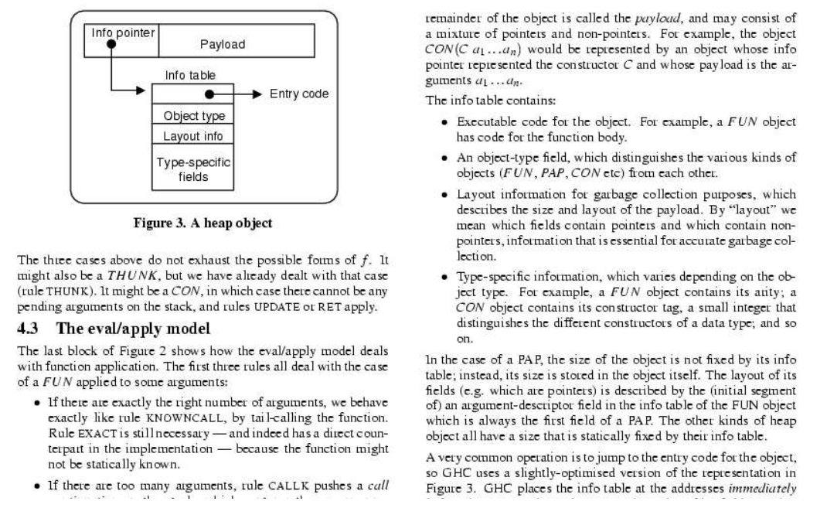
Visual structure

Slide 29
Active voice
It can be seen that...
We can see that...
We the authors and the reader
It might be thought that this would be a type error.
You might think this would be a type error
You the author

Slide 30
Simple, direct language
The object under study was displaced horizontally
The ball moved sideways
On an annual basis
Yearly
Endeavor to ascertain
Find out
It might be considered that the speed of storage reclamation left something to be desired
The garbage collector was really slow

Slide 31
Summary
If you remember nothing else
Identify your key idea
Identify your contributions explicitly
Use examples

Slide 32
That’s it. Thank you!

